Slide 1


Hybrid Safety Solutions Presentation
Chris Brogli - Ross Controls
Global VP of Safety Business Development Manager
chris.brogli@rosscontrols.com
1-859-595-9630
Confidential & Privileged C 2021 ROSS Controls All Rights Reserved

Slide 2

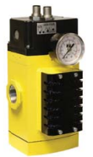
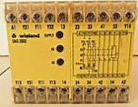
Hybrid Safety Solutions include electrical, electronic and fluid power solutions.
Hybrid safety solutions use a combination of electrical, electronic and electro-mechanical devices to control the sources of hazardous energy.
Input/Triggering Device
Logic Device
Output Device
Complete Safety Function
+
+
=
Confidential & Privileged C 2021 ROSS Controls All Rights Reserved

Slide 3
Determination of the type of safety devices should be determined thru the use of a risk assessment.
Risk Assessment
Electrical
Fluid Power
Lockout/Tagout
Holistic risk assessments consider all sources of hazardous energy and includes lock-out/tag-out.
Confidential & Privileged C 2021 ROSS Controls All Rights Reserved

Slide 4
Most of the identified risk reduction measures are similar in electrical and fluid power.
Electrical Terms
Prevention of unexpected start-up
Energy Isolation
Safe-direction
Safe-torque-off
Safe-speed
Safe-stopping
Safe-brake control
Safe-limited-torque
Fluid Power Terms
Prevention of unexpected start-up (LOX)
Energy Isolation (Safe-exhaust)
Safe-direction (Safe-return)
Safe-torque-off (Safe-exhaust)
Safe-speed (Flow controls)
Safe-stopping (PO Checks)
Safe-brake control (Safe-return)
Safe-limited-torque (Safe-exhaust)
The terms might be different, but the functionality is the same.
Confidential & Privileged C 2021 ROSS Controls All Rights Reserved

Slide 5





Prevention of Unexpected Start-up is covered by Enegry Isolation or Lock-out/Tag-out
Hierarchy of Protective Measures
  These measures are often combined to reduce risk to an acceptable level.
Elimination
Fixed Guarding
Engineered Safeguards
Fixed Guarding
Awareness Means, Training and Procedures (Administrative)
Personal protective equipment
Confidential & Privileged C 2021 ROSS Controls All Rights Reserved

Slide 6
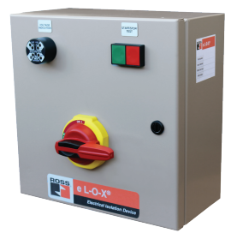
LOTO Device Considerations & Best Practices
Device Requirements
A manually operated actuator
Not be used for any other function
Located outside of hazardous areas
Easily identified and easily operated
Tamper-resistant
Lockable only in the off position
Means of energy dissapation

Slide 7
Routine, repetitive and integral tasks are treated with risk reduction measures that use these hybrid functions.
Electrical Terms
Prevention of unexpected start-up
Energy Isolation
Safe-direction
Safe-torque-off
Safe-speed
Safe-stopping
Safe-brake control
Safe-limited-torque
Fluid Power Terms
Prevention of unexpected start-up (LOX)
Energy Isolation (Safe-exhaust)
Safe-direction (Safe-return)
Safe-torque-off (Safe-exhaust)
Safe-speed (Flow controls)
Safe-stopping (PO Checks)
Safe-brake control (Safe-return)
Safe-limited-torque (Safe-exhaust)
Every mode and every task must be evaluated in order to identify all of the hazards.
Confidential & Privileged C 2021 ROSS Controls All Rights Reserved

Slide 8
This where safeguarding solutions come into consideration.
Hierarchy of Protective Measures
  These measures are often combined to reduce risk to an acceptable level.
Elimination
Fixed Guarding
Engineered Safeguards
Fixed Guarding
Awareness Means, Training and Procedures (Administrative)
Personal protective equipment
Confidential & Privileged C 2021 ROSS Controls All Rights Reserved
Notes:
This slides shows the recommended path for risk reduction
Designing out the hazard is most effective
PPE is Least effective – Note that following procedures is paramount to reducing risk, but is least effective because we do not always follow directions.
When we do not follow directions, we are exposed to a higher level of risk – (i.e. Speeding, driving too fast for the conditions (Ice, Snow, poor visibility))
PPE when worn appropriately does provide a significant level of protection.

Slide 9
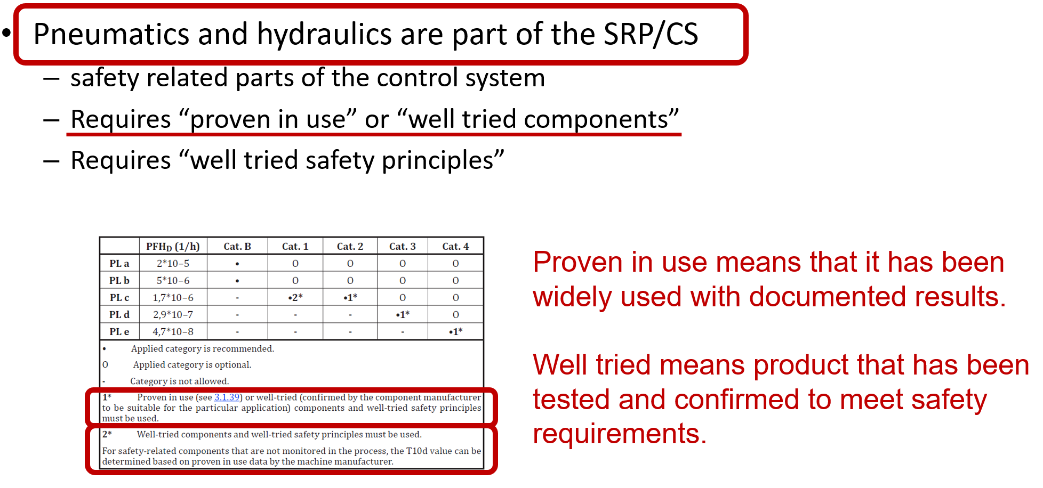
ISO 13849-1 – requires users to include fluid power safety as part of the safety control system.
Most metals companies ignored pneumatics and hydraulics until the ISO13849 standard included pneumatics and hydraulics as part of the safety related part of the control system.

Slide 10

Most safety functions start with a triggering event called Safety-related stop.
Confidential & Privileged C 2021 ROSS Controls All Rights Reserved

Slide 11
This trigger device starts the safety function action and the logic device controls the action.
Input/Triggering Device
Logic Device
Output Device
Complete Safety Function
+
+
=
Confidential & Privileged C 2021 ROSS Controls All Rights Reserved

Slide 12
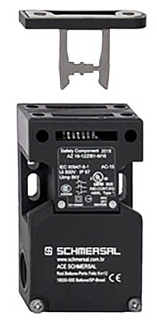
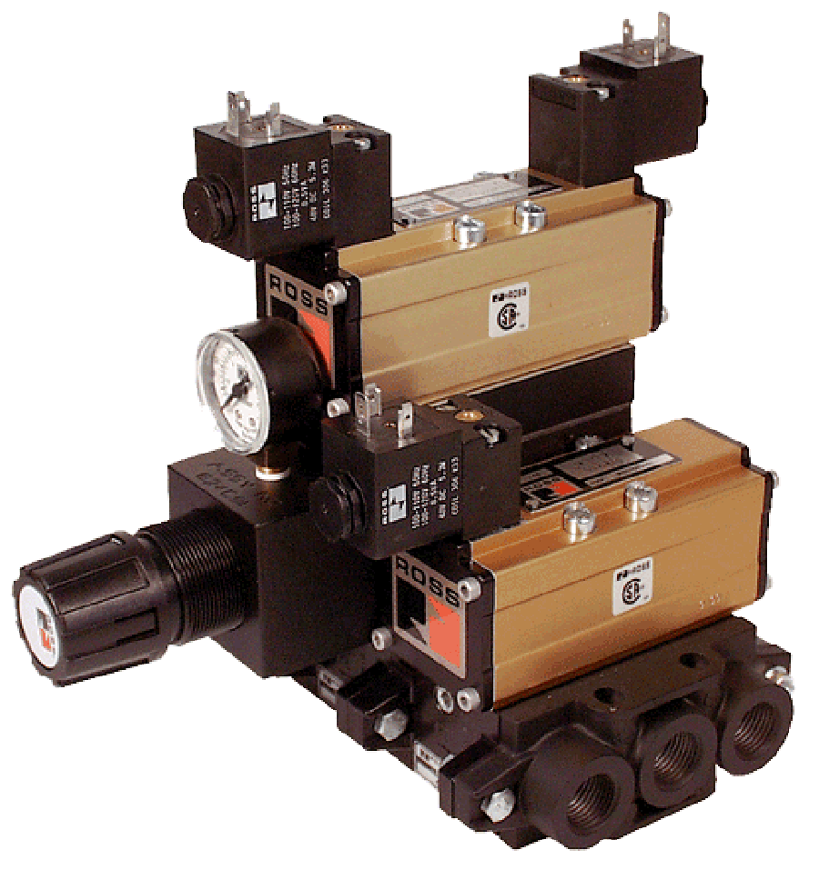
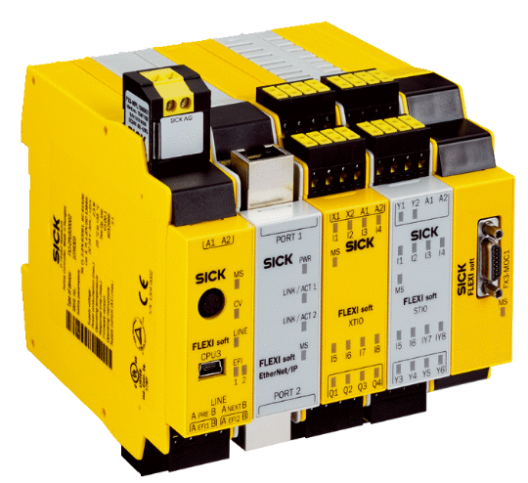
A Safety Function includes fluid power safety.
Cat4
Cat4
Cat1
Cat1
+
+
=
Incomplete Safety Function
Unfortunately, most people think that turning power off to standard valves is enough. The problem is that valves are only CatB or Cat1 devices.
Cat4
Cat4
Cat4
Cat4
+
+
=
Complete Safety Function
Confidential & Privileged C 2021 ROSS Controls All Rights Reserved

Slide 13
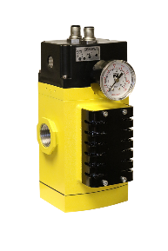
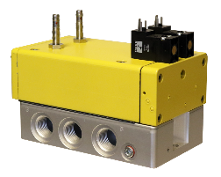
Common Pneumatic Safety Solutions.
Pneumatic Safety Valve Systems
Manual Lockout Valves
Safe Dual Pressure Select
Safe Exhaust
Safe Return
Sale Load Holding
Safe Dual Pressure Supply
Safety Expertise and Global Support

Slide 14
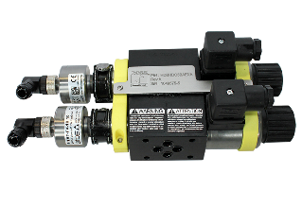
Common Hydraulic Safety Solutions.
Hydraulic Safety Valve Systems
Energy Isolation Lockout
Block & Bleed
Block & Stop
Future
Dual Block & Stop
Safe Return
Safe Dual Pressure Supply
Future
Future
Safety Expertise and Global Support

Slide 15
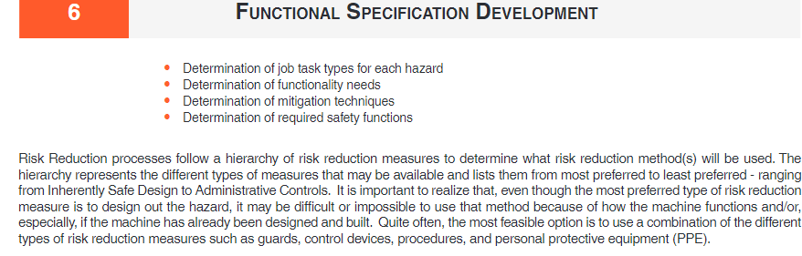
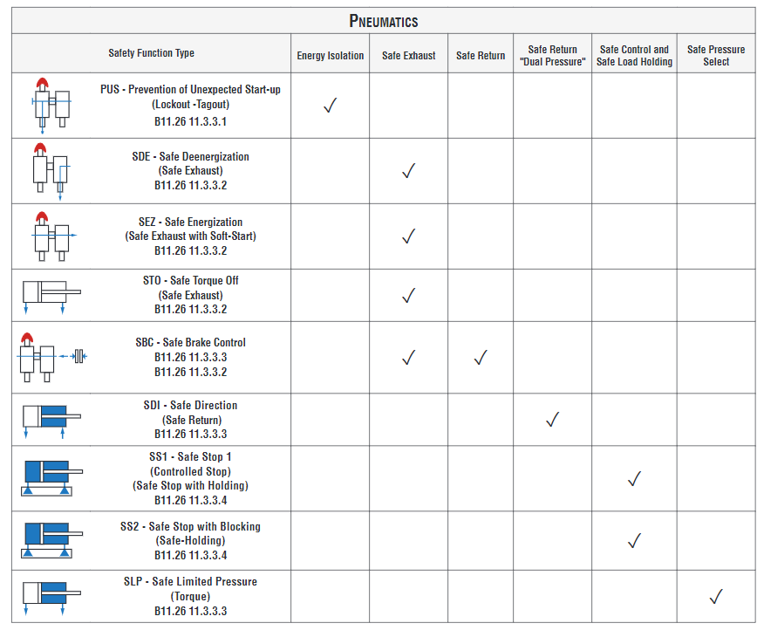
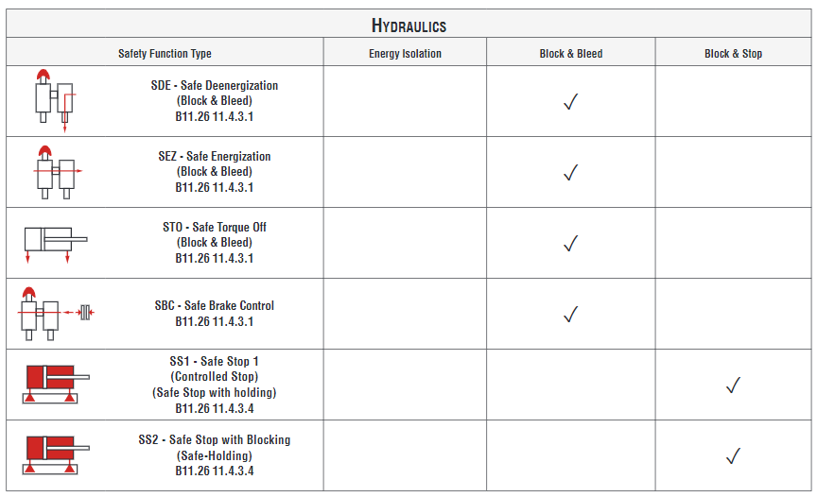
Functional Specifications should identify which function is to be used to reduce risk.
Confidential & Privileged C 2021 ROSS Controls All Rights Reserved

Slide 16
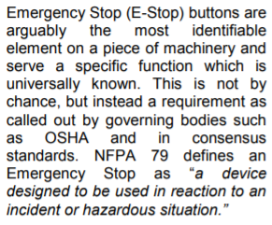

Emergency stop requirements from NFPA79
To be used in reactions to an incident or hazard
Confidential & Privileged C 2021 ROSS Controls All Rights Reserved

Slide 17
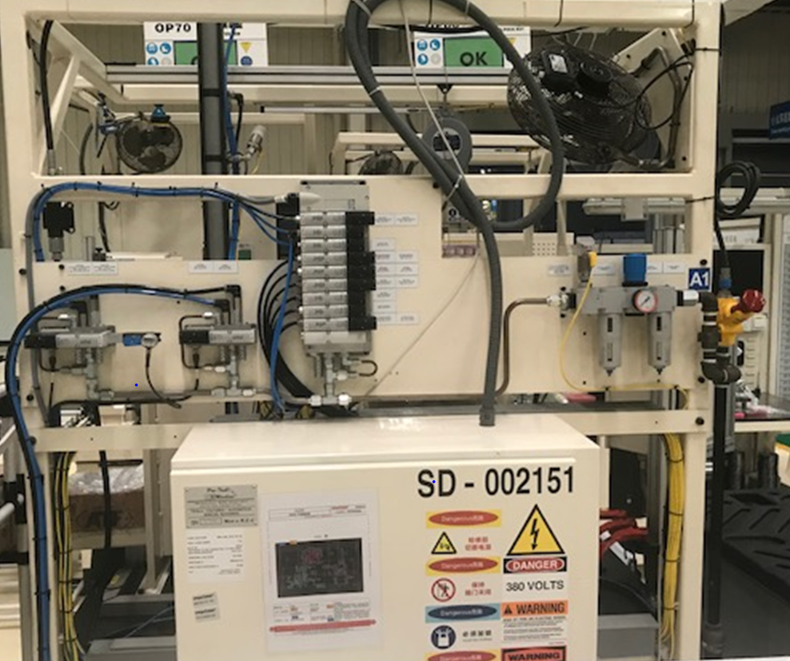
Unfortunately, most machine do not have a safety dump valve to isolate or control fluid power energy sources.
Air Supply Line
Lock-out/Tag-out Device
Standard Pneumatic Control Valves
Guess what’s missing?
The Safe-exhaust Valve!
This is quite common in industry today. It is the same situation for hydraulic systems.
Confidential & Privileged C 2021 ROSS Controls All Rights Reserved
Page 55 of 56

Slide 18
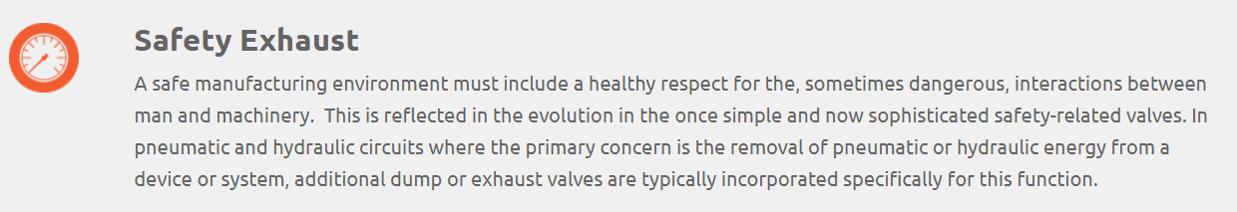
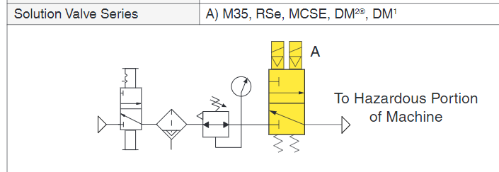
Safe Exhaust dumps pneumatic energy to inhibit the ability to generate force and pressure.
Confidential & Privileged C 2021 ROSS Controls All Rights Reserved

Slide 19

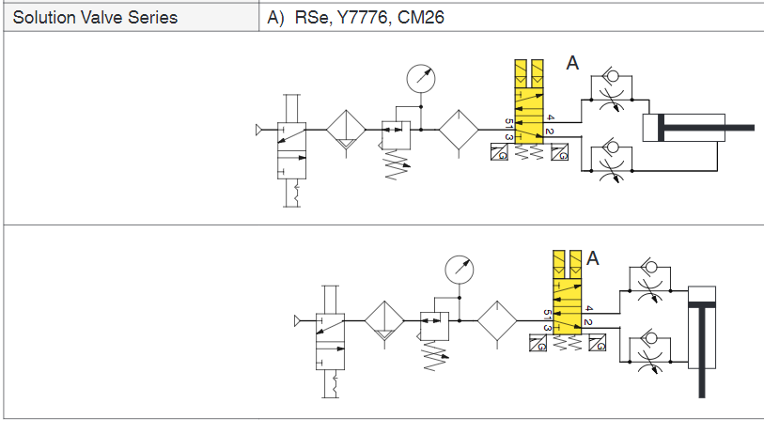
Safe return changes the direction of travel of an actuator which eliminates a potential hazard.
Confidential & Privileged C 2021 ROSS Controls All Rights Reserved

Slide 20
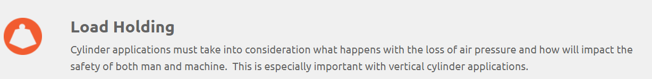
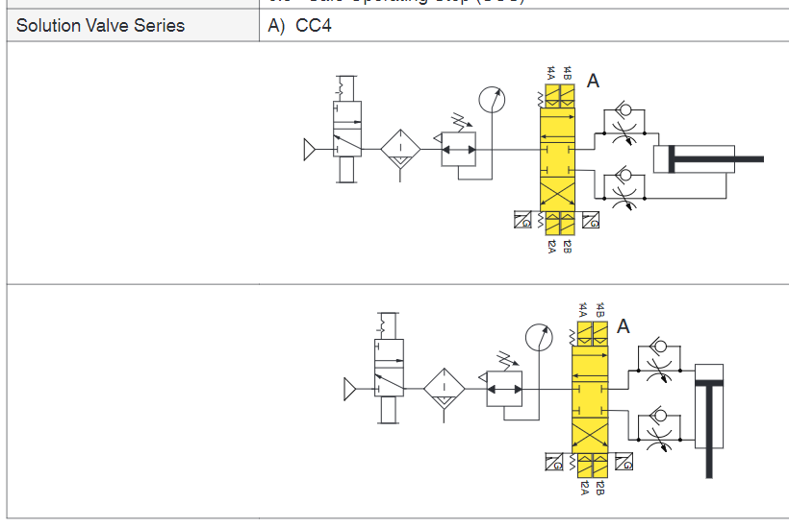
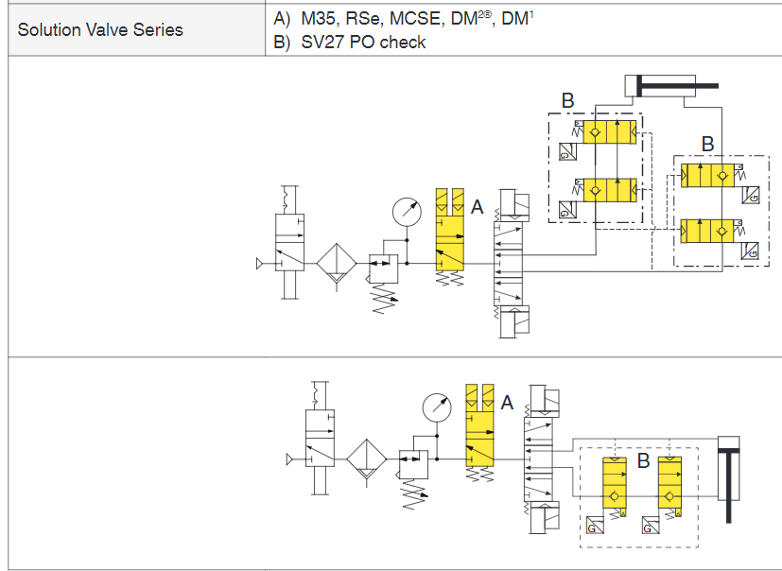
Safe load holding stops travel of an actuator and holds a load on place which eliminates a potential hazard.
Confidential & Privileged C 2021 ROSS Controls All Rights Reserved

Slide 21
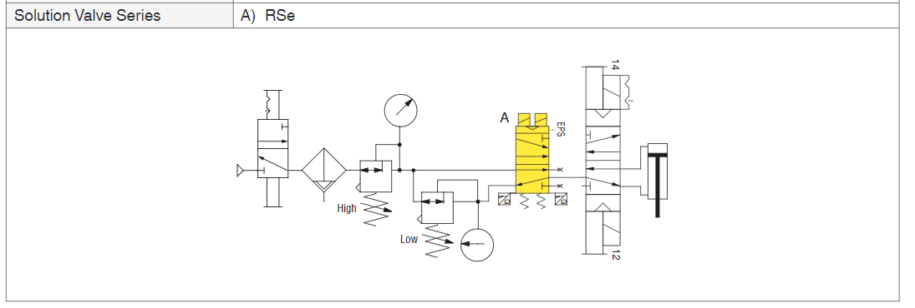
Safe Exhaust dumps pneumatic energy to inhibit the ability to generate force and pressure.
Safe Pressure Select
Safe pressure select is used to switch back and forth between full pressure and a safe pressure that allows operators to interact with the machine with reduced risk of energy.
Confidential & Privileged C 2021 ROSS Controls All Rights Reserved

Slide 22
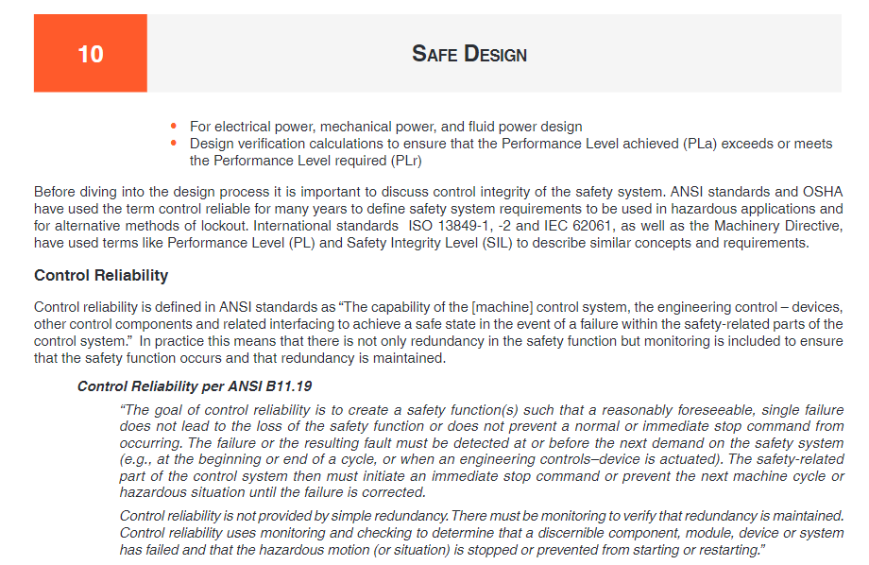
Safe Design Requirements
Confidential & Privileged C 2021 ROSS Controls All Rights Reserved

Slide 23
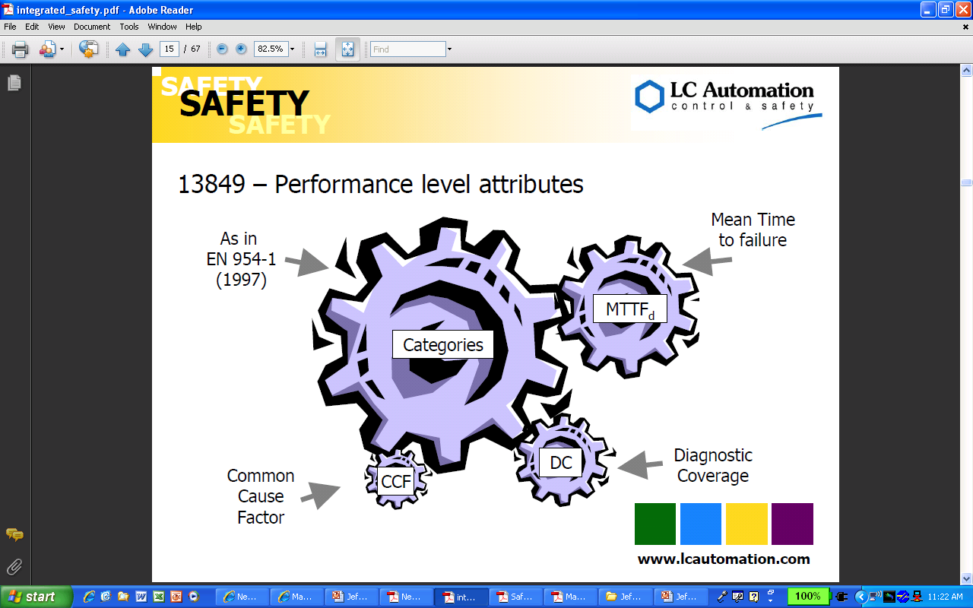
Safe Design Factors
Identify the Structure (Cat)
Determine the Reliability of the System (MTTFd)
Determine the Diagnostic Coverage of the System (DC)
Determine the Common Cause Failures of the System (CCF)

Slide 24
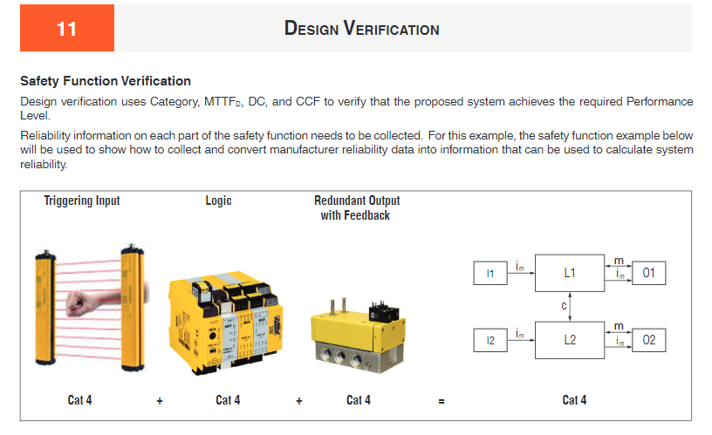
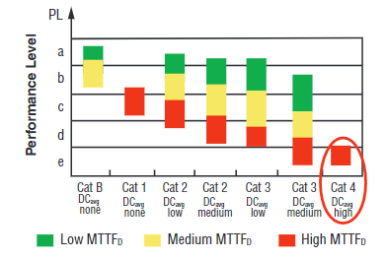
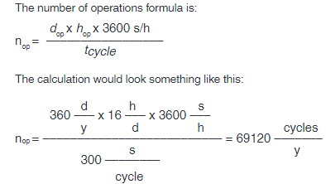
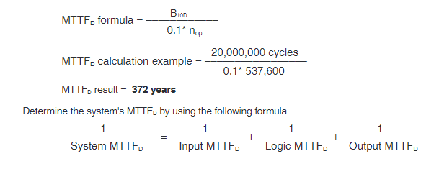
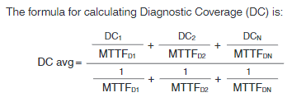
Safe Design Verification Calculations
Confidential & Privileged C 2021 ROSS Controls All Rights Reserved

Slide 25
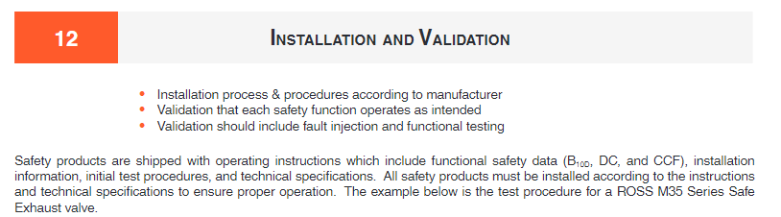
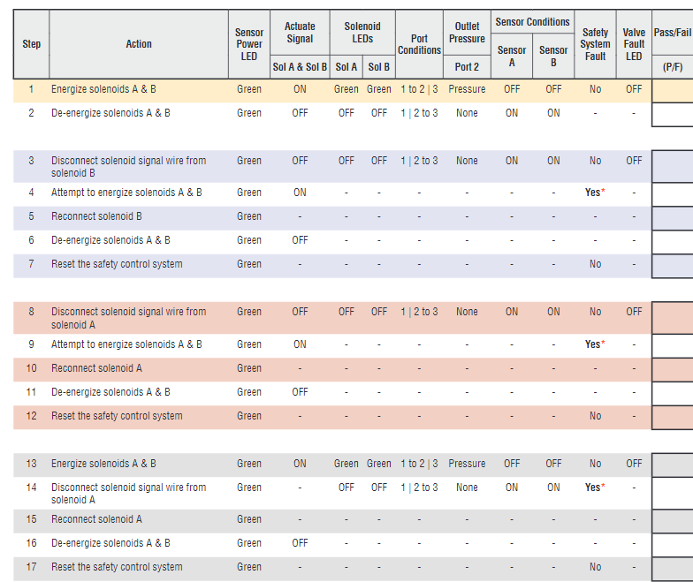
Installation & Validation
Confidential & Privileged C 2021 ROSS Controls All Rights Reserved

Slide 26
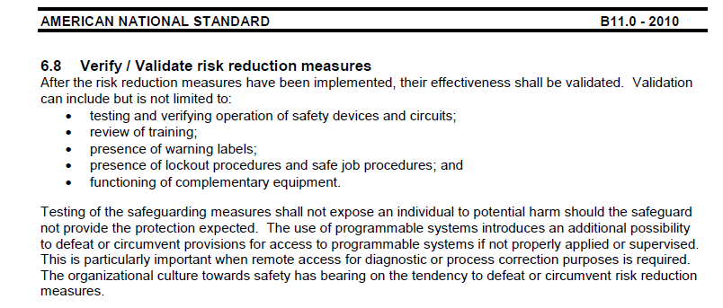
ANSI V&V Requirements
Confidential & Privileged C 2021 ROSS Controls All Rights Reserved

Slide 27
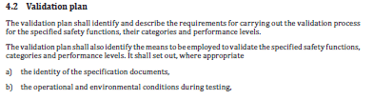

Validation is required before putting the machine/system into use.
ISO13849-2 Validation Requirements
Confidential & Privileged C 2021 ROSS Controls All Rights Reserved

Slide 28
Session wrap-up
Thank you for attending today’s session. A few key points to remember:
Safety doesn’t end at the wire.
Fluid power safety is a requirement.
Fluid power safety solutions are almost always integrated with electrical input and electrical logic devices.
Don’t forget that your machine is only as safe as the weakest link. If you haven’t done anything with fluid power, your machine is probably not compliant.
Confidential & Privileged C 2021 ROSS Controls All Rights Reserved

